Slide 1

AquaWatch
Real‑time water quality monitoring dashboard for rural drinking water sources
Presented by:
P.Srija-2510040083
Sania Khan-2510040070
K.Sravya-2510040109
B.Gowri-2510040120

Slide 2


Why this matters
Safe drinking water is essential, yet many rural communities lack regular testing. Contamination often goes unnoticed until people fall ill. AquaWatch provides continuous monitoring so problems are detected early and action can be taken before outbreaks occur.
Designed for rural development officials and nontechnical stakeholders — clear, low‑cost, and actionable.

Slide 3

Problem Statement
Rural areas face four core challenges:
Limited access to testing laboratories
Manual tests are expensive and infrequent
Contamination is detected only after illness
Authorities lack real‑time visibility
Impact : higher waterborne disease rates, delayed responses, and rising healthcare costs.

Slide 4
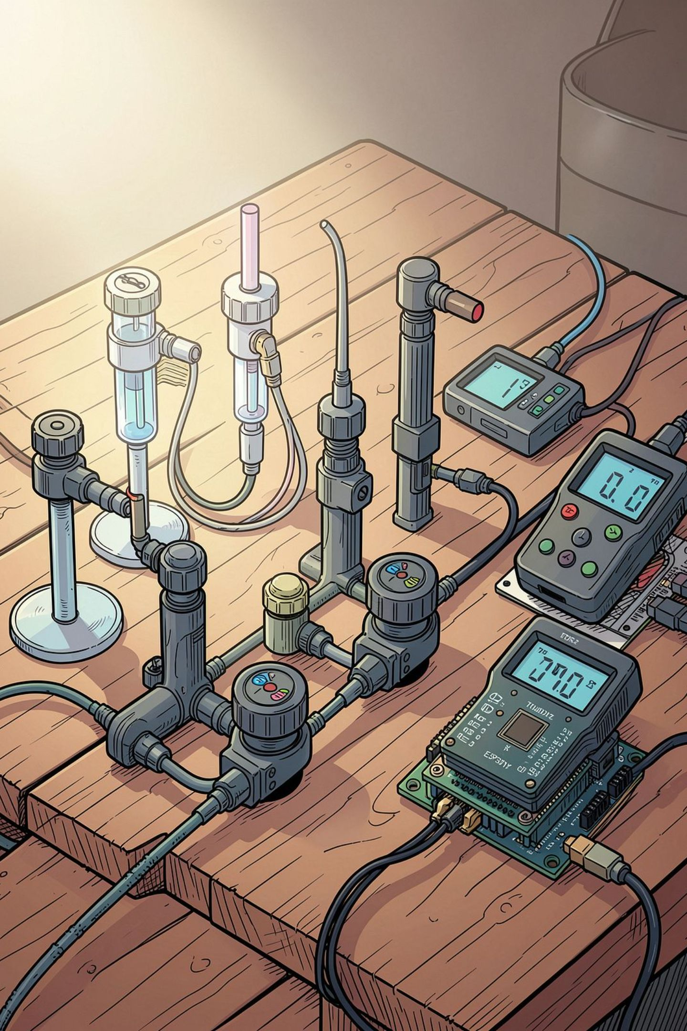
Proposed Solution — AquaWatch
An affordable IoT system that continuously measures pH, turbidity, and TDS, streams data to the cloud, visualizes readings on a live dashboard, and sends automatic alerts (SMS/email/local buzzer) when thresholds are exceeded.
Continuous Monitoring
Second‑by‑second readings for early detection
Real‑time Dashboard
Accessible remotely for officials and caretakers
Automatic Alerts
SMS, email, and optional local buzzer notifications
Low Cost
Uses affordable sensors and ESP32 for wide deployment

Slide 5

System Architecture
Sensing
Local Processing
Cloud Upload
Alerts & Dashboard
Steps: sensor capture → local processing on ESP32 → data published via MQTT → backend subscribes and bridges to WebSocket → dashboard updates in real time → automated alerts trigger when safe ranges are exceeded.

Slide 6
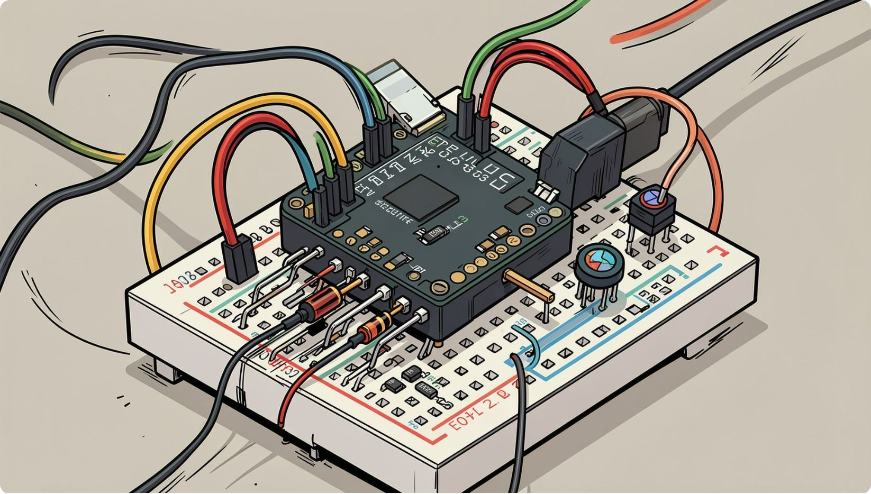
Hardware Components
Component
Role
ESP32
Reads sensors, Wi‑Fi upload, low power
pH Sensor
Measures acidity (safe: 6.5–8.5)
Turbidity Sensor
Detects suspended particles / cloudiness
TDS Sensor
Measures dissolved solids (salts/minerals)
OLED / Buzzer
Local display and audible alert
ESP32 chosen for built‑in Wi‑Fi, low cost, and low power consumption.

Slide 7
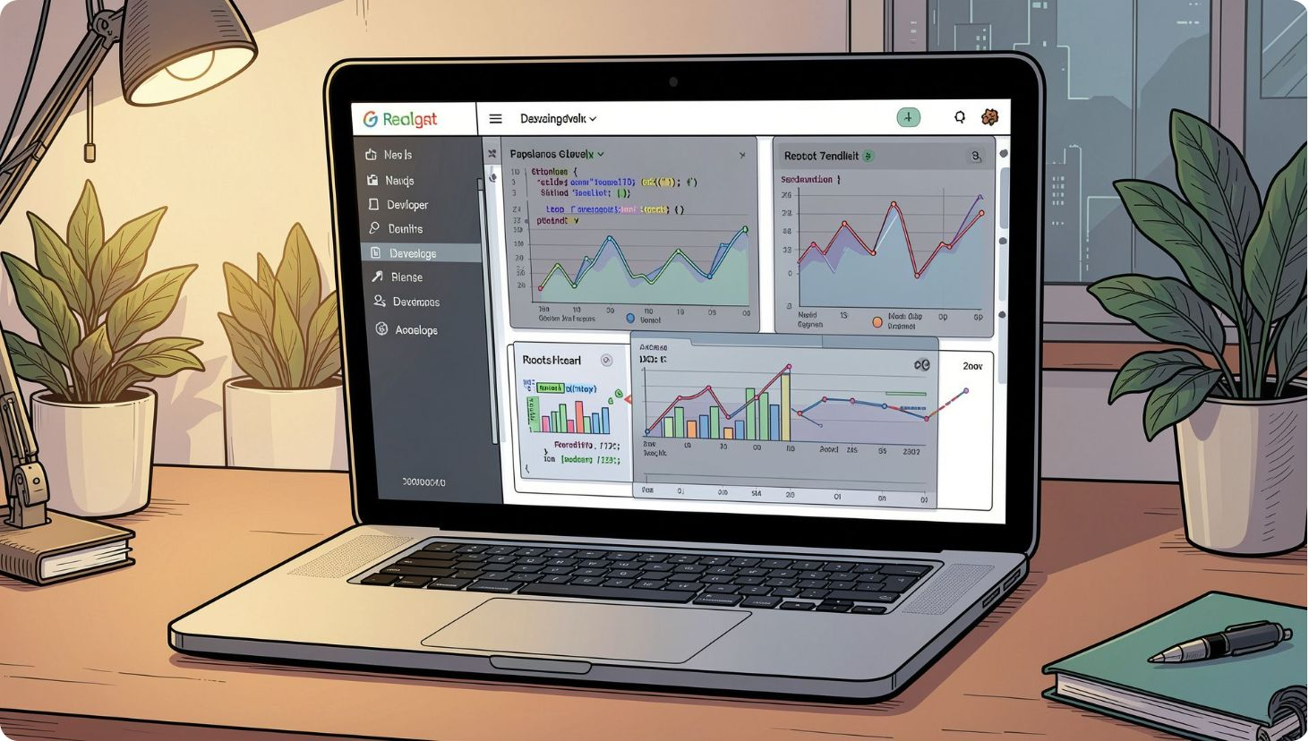
Software Stack
Arduino IDE — ESP32 firmware
Firebase — real-time database and secure storage
React.js + Chart.js — interactive dashboard and graphs
Twilio / EmailJS — automated SMS and email alerts
Design emphasis: simple deployment, secure cloud sync, and an intuitive dashboard for nontechnical users.

Slide 8
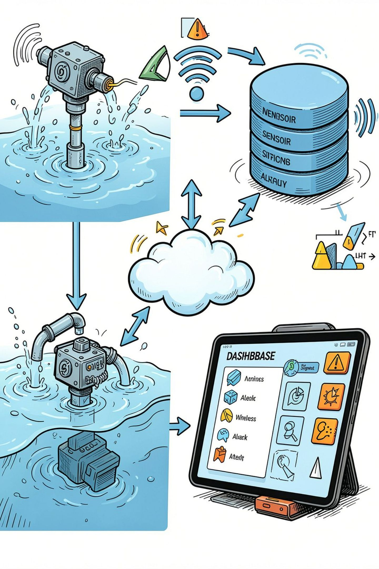
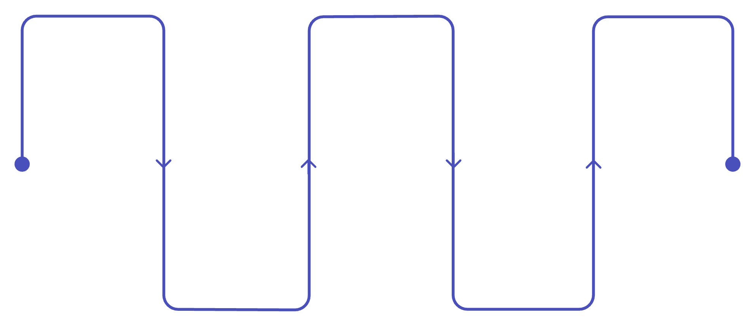
Working Process (At a glance)
Sensors Deployed
ESP32 Reads
Firebase Stores
Collects sensor values
Placed in water bodies
Database and dashboard update
Measure Parameters
Send via Wi‑Fi
pH, turbidity, TDS readings
Transmit data to cloud
The full loop completes within seconds: measurement → transmission → visualization → notification for rapid local response.

Slide 9



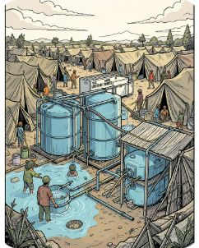
Impact & Applications
Scalable to government supply systems, purification plants, and smart‑village initiatives.
Village Water Tanks
Schools & Hospitals
Disaster Relief
Continuous monitoring prevents large‑scale contamination.
Protects vulnerable populations with timely alerts.
Fast deployment for emergency water safety monitoring.

Slide 10
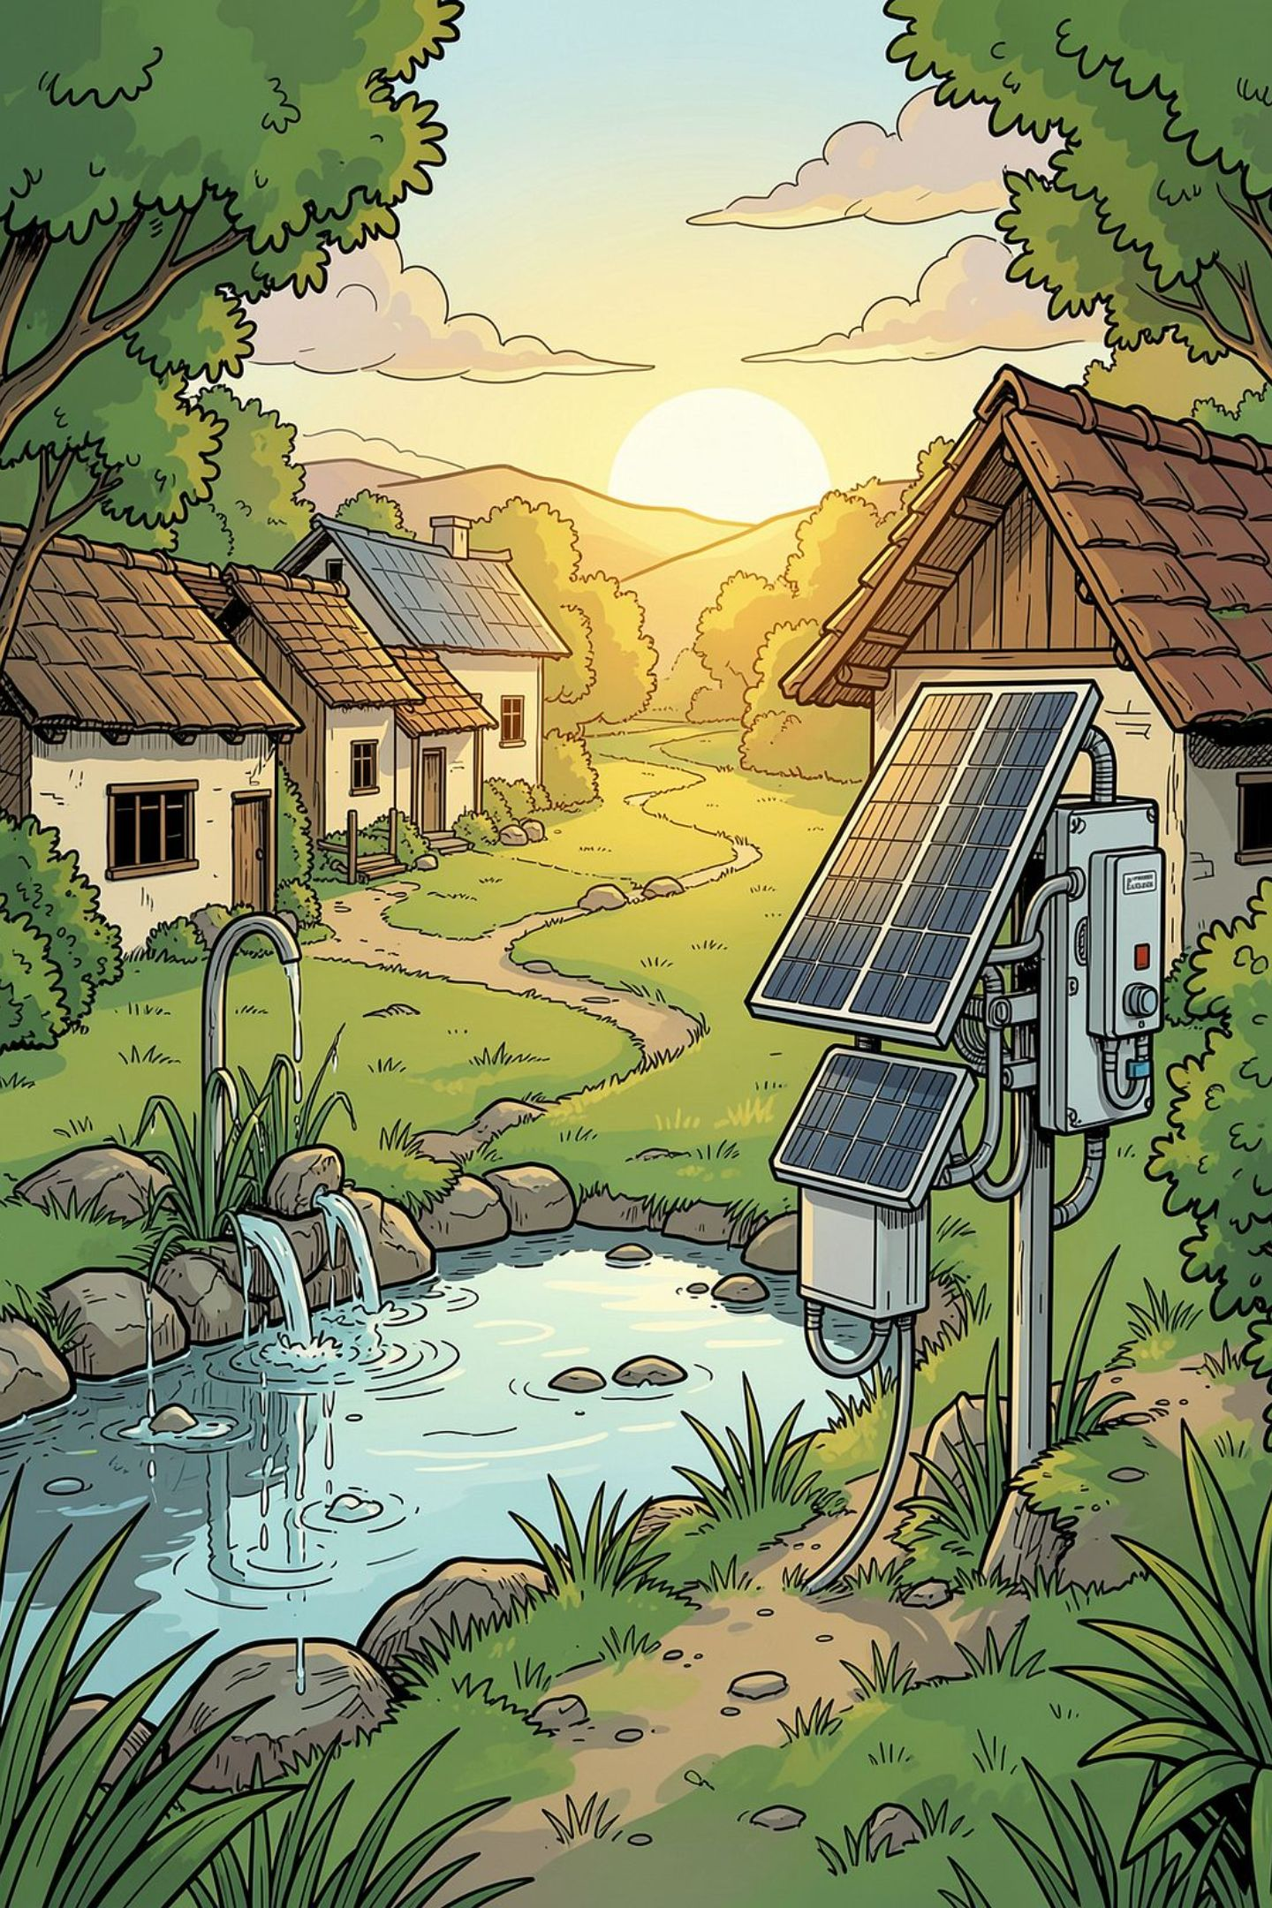
Future Roadmap & Conclusion
1
2
AI Predictions
Mobile App
Machine learning to forecast contamination events from historical data
Push notifications and localized guidance for caretakers
3
4
Solar Power & GPS
Additional Sensors
Off‑grid monitoring with geolocation for fleet management
Temperature, dissolved oxygen, residual chlorine for richer analysis
AquaWatch is an affordable, practical solution to reduce waterborne disease by detecting contamination early and empowering rural authorities with real‑time data.

